Slide 1
Providing Hyper parameter tuning for Decision Tree Regression from Scratch
~ Suhas D S

Slide 2
Table Of Content:
Importing Libraries
Loading Data
Data Overview
EDA
Preprocessing Data
Splitting Data
Model Building From Scratch
Comparing model with Sklearn model
Hyper parameter tuning
Conclusion

Slide 3
Problem Statement:
Determine the RED WINE QUALITY dataset and developing a Decision tree regression model to predict the Quality based on the given features .

Slide 4
Attribute Information:
Input variables (based on physicochemical tests):
fixed acidity
volatile acidity
citric acid
residual sugar
Chlorides
free sulfur dioxide
total sulfur dioxide
Density
pH
Sulphates
alcohol
quality (score between 0 and 10) O/p

Slide 5
Features of the Dataset
Rows:
* We have 1599 rows in our dataset
Features:
* We have 12 columns in that
- 12 numerical features
- 0 categorical features
Target Variable: Quality
Problem Type- Regression type

Slide 6
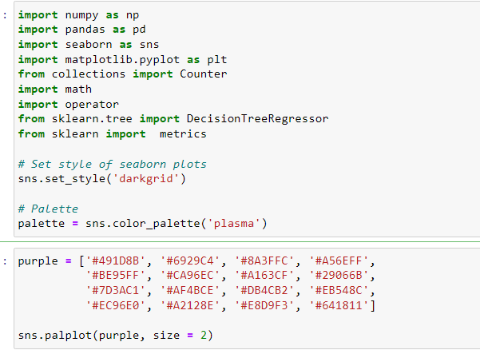
📚 IMPORTING LIBRARIES
In the above code I imported some Libraries which we required for our data set

Slide 7
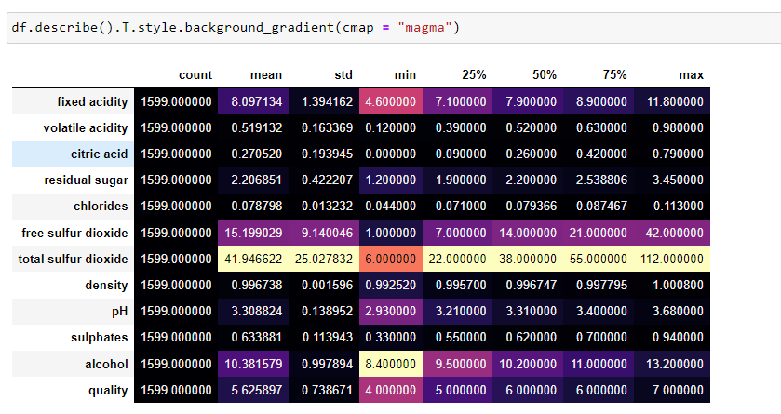
Data.describe() it gives us summary statistics for numerical columns in our dataframe

Slide 8
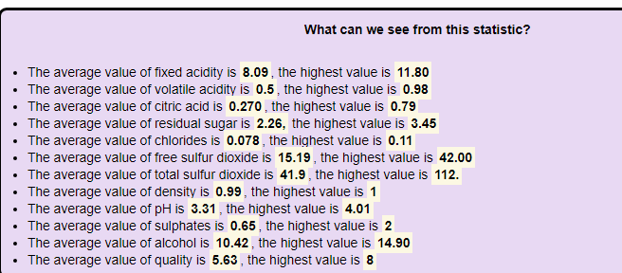
From Describe() We can summarize and visualize the statistical analysis for our dataframe

Slide 9
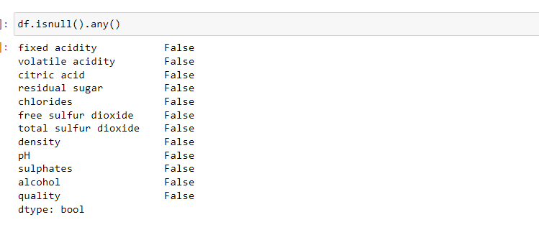
There are no NULL VALUES in our dataset. Total “null” values in dataset Is zero

Slide 10
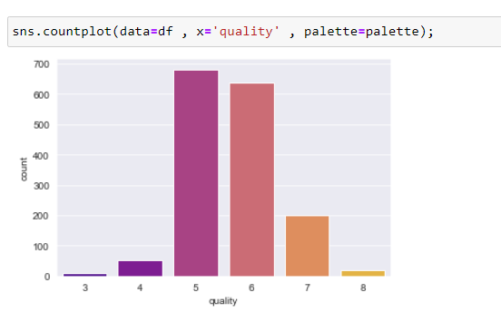
Exploratory data analysis
From the above graph , we can understand that Quality of 5 & 6 is high and the top ratting is about 7 to 8

Slide 11
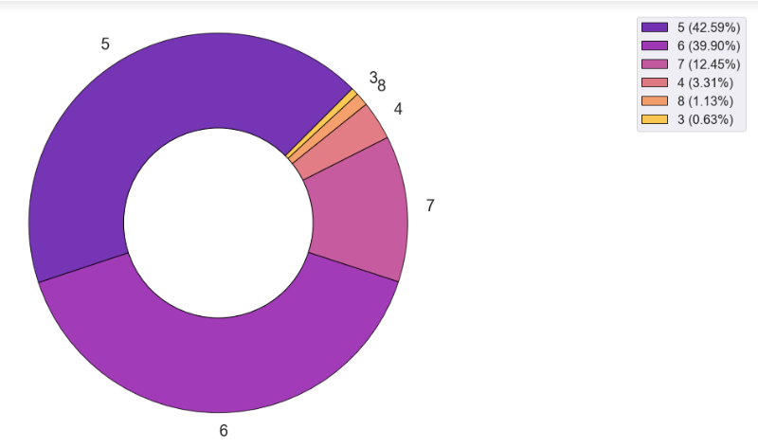
Around 42% of wine quality is 5 rated and least is .63% for 3 ratting

Slide 12
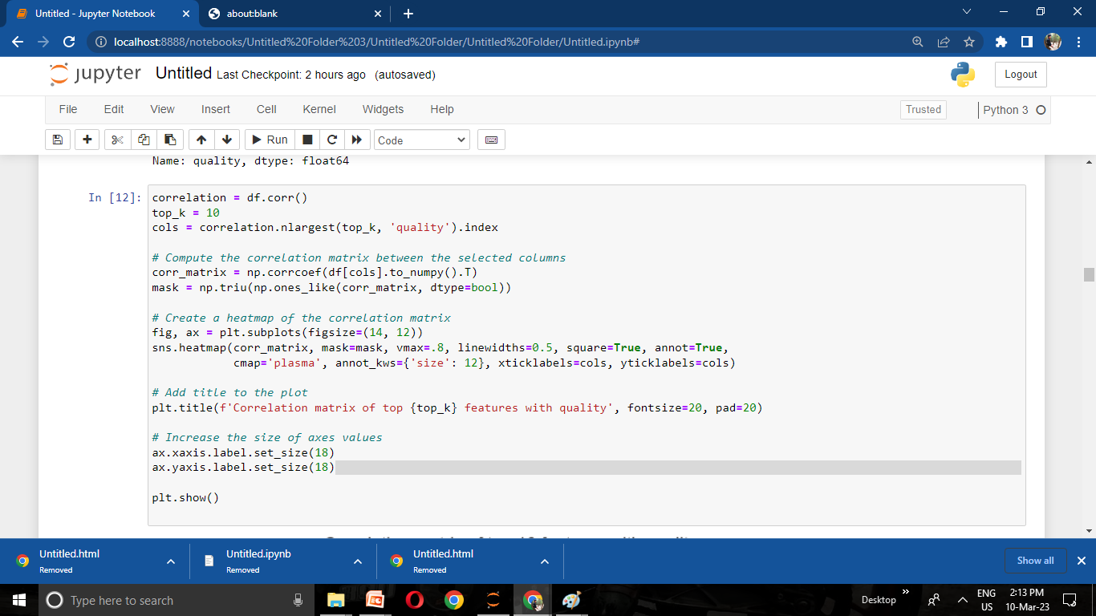
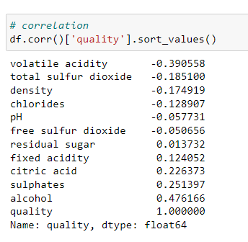

Slide 13
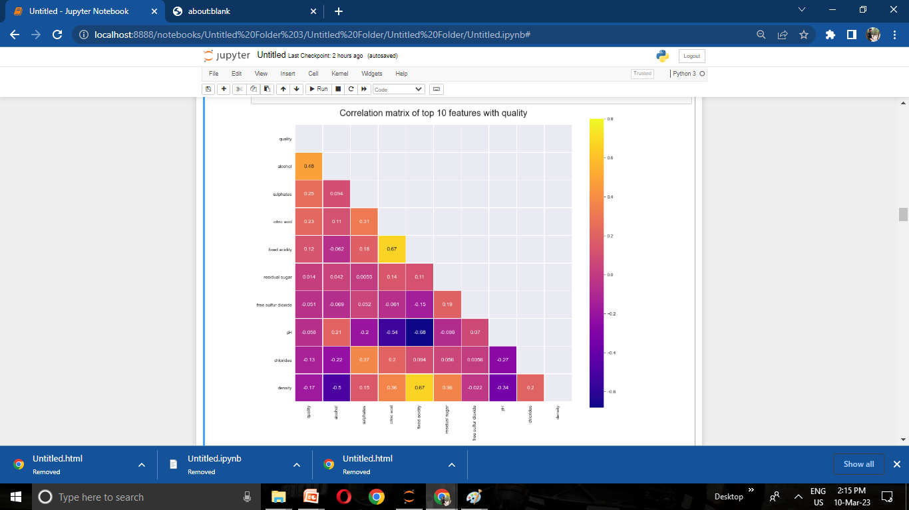
Correlation graph is very useful to highlight the most correlated variables in a data table

Slide 14
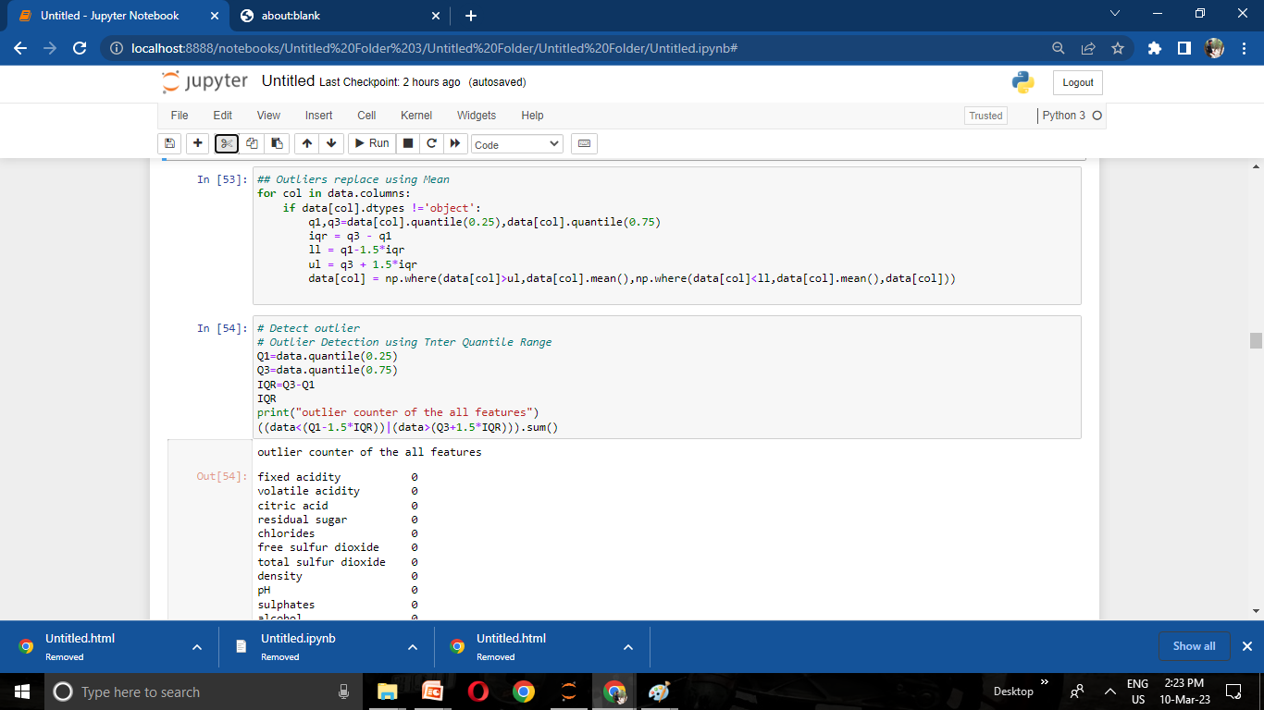
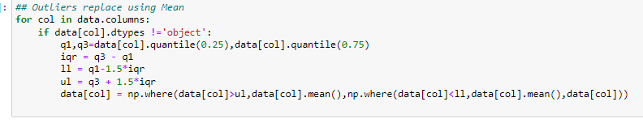
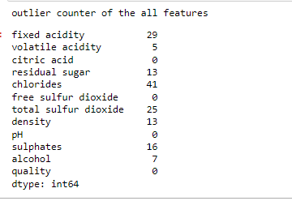
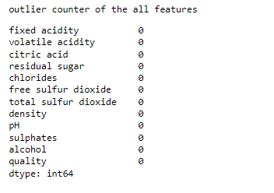
Treating Outlier:

Slide 15
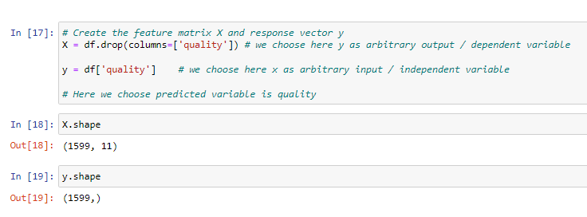
Splitting the data
We choose here X as arbitrary input and it is independent variable
We choose here y as arbitrary output and it is dependent variable

Slide 16
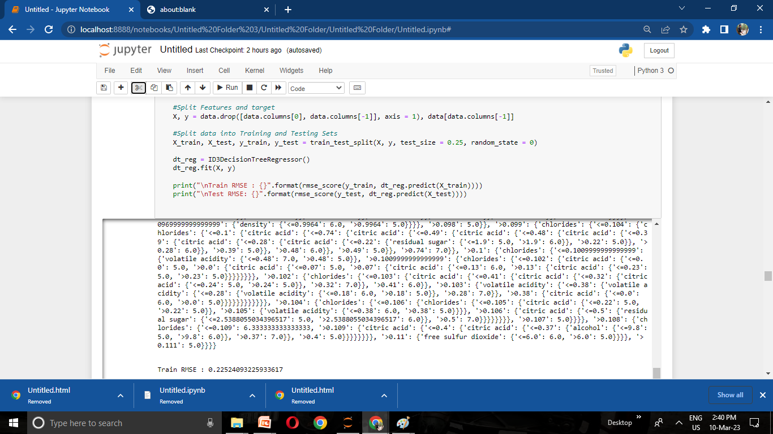
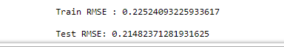
Building Decision tree regression
I implemented Decision tree regression using ID3 algorithm by replacing information gain with Standard deviation reduction and predicted wine quality
RMSE score :
1) for train = 0.225
2) for test = 0.214

Slide 17
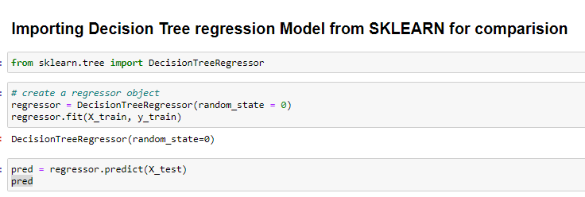
Here I imported Decision tree regression from Sklearn to compare my model which I did from scratch

Slide 18
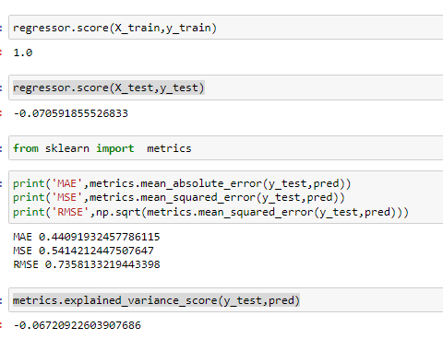
This is the score which I got using sklearn Decision tree regression

Slide 19
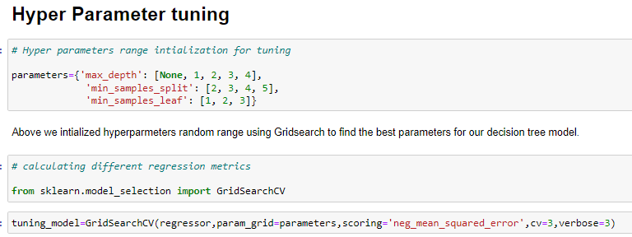
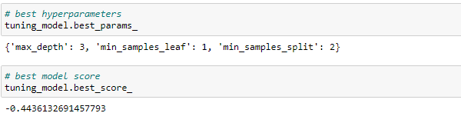
Here I provided hyper parameter tuning for my model to get best parameters
These are the best parameters I got after tuning the model

Slide 20
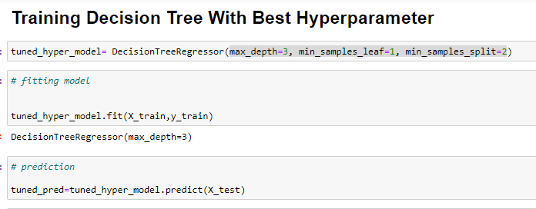
Giving the best params and tuning model for prediction

Slide 21
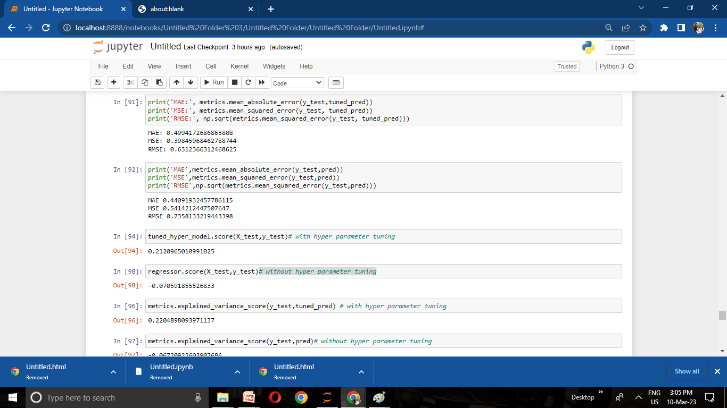
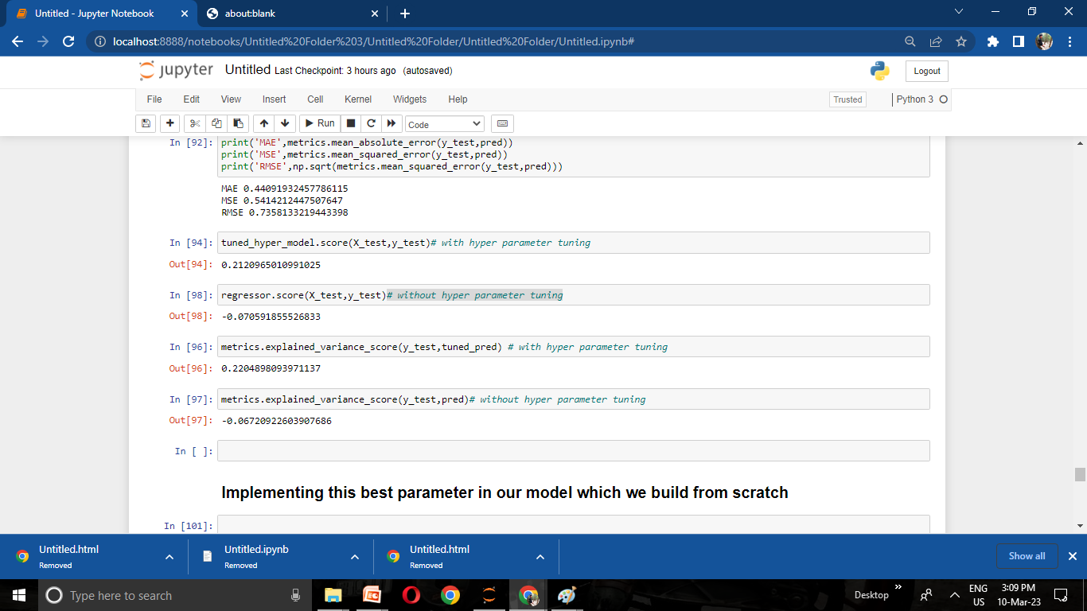
With Hyper parameters
Without Hyper parameters

Slide 22
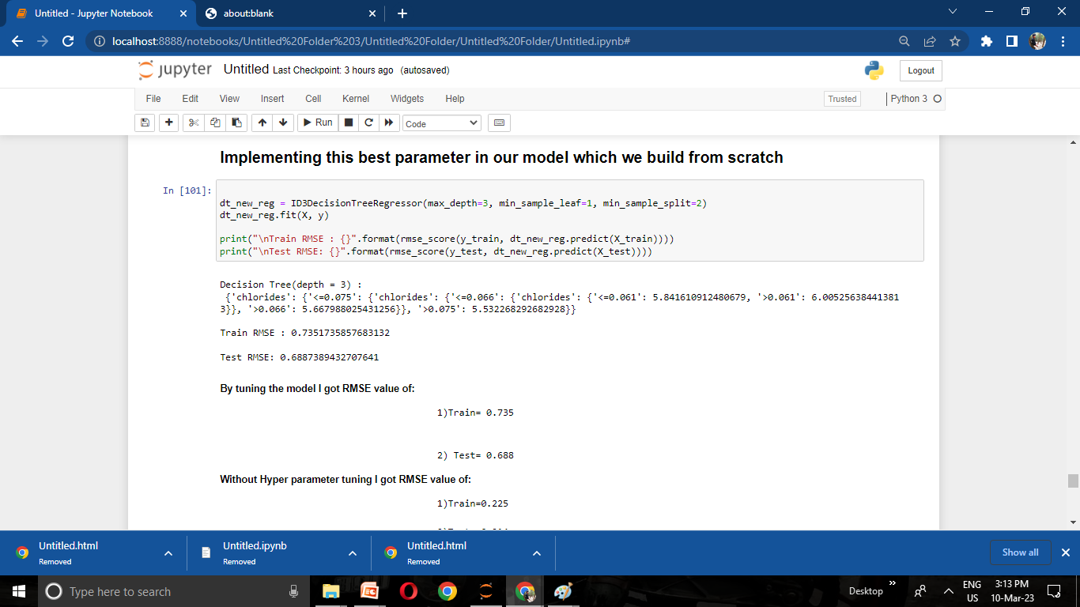
Providing same parameters to my model which I created from scratch
And I got RMSE value: train= 0.735
test= 0.688

Slide 23
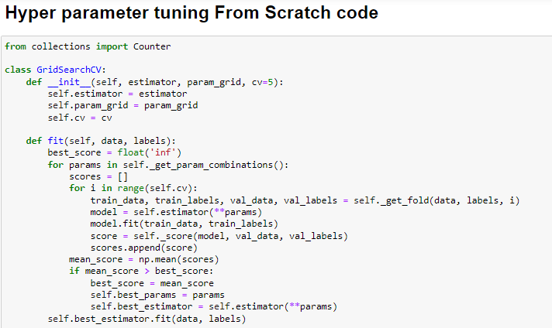
Here I did a code for GridsearchCV from scratch for tuning model

Slide 24
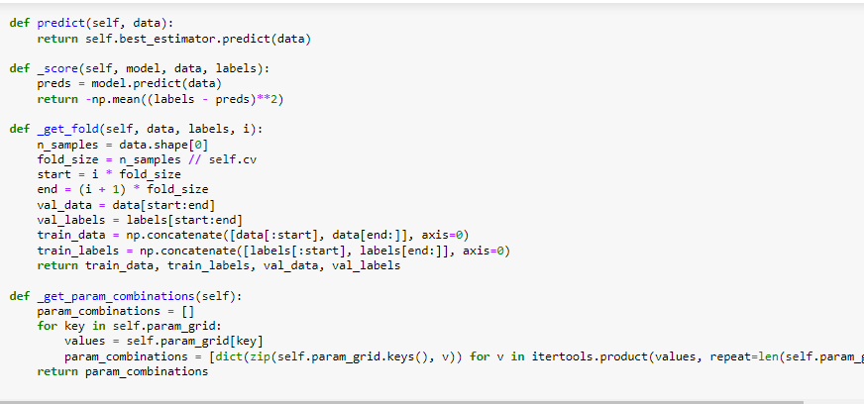
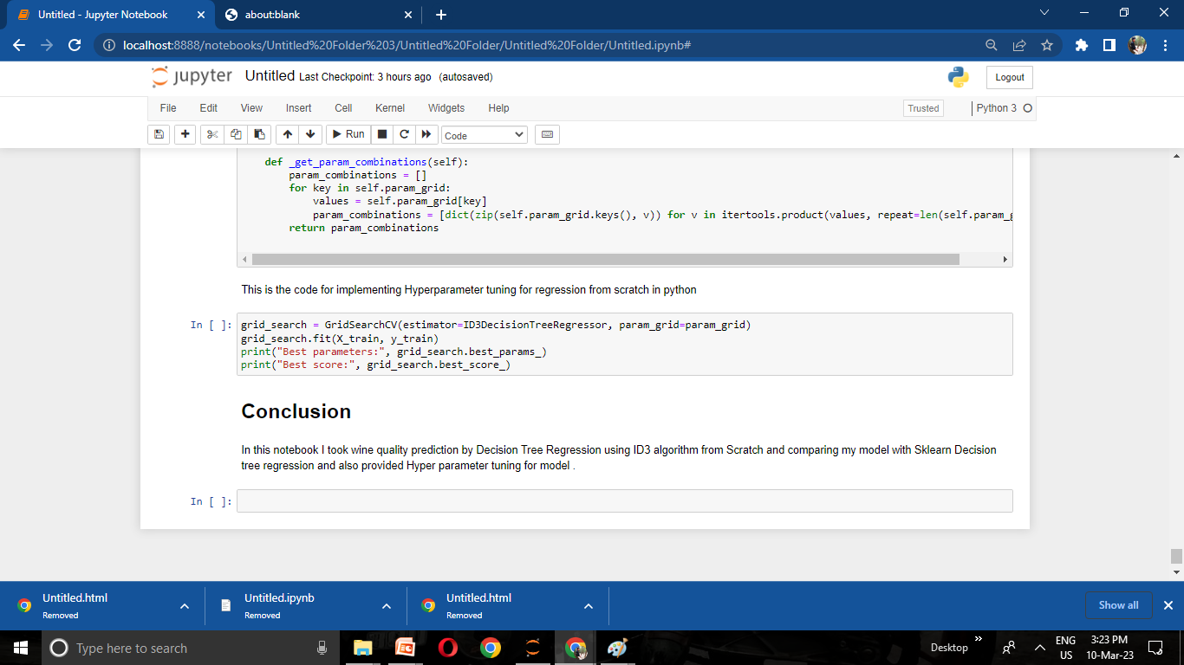

Slide 25
Conclusion:
In this notebook I took wine quality prediction by Decision Tree Regression using ID3 algorithm from Scratch and comparing my model with Sklearn Decision tree regression and also provided Hyper parameter tuning for model
THANK YOU

